Slide 1



Contoso Sales Analysis Dashboard
View in Power BI
Done By Mohamed Atwan.
Mail Me At : Mo7amed3twan@gmail.com
Linked IN :
https://www.linkedin.com/in/mohamed-elsayed-7aaa81223/
Portfolio :
https://mo7amed3twan.github.io/ProtofolioWebsite/

Slide 2
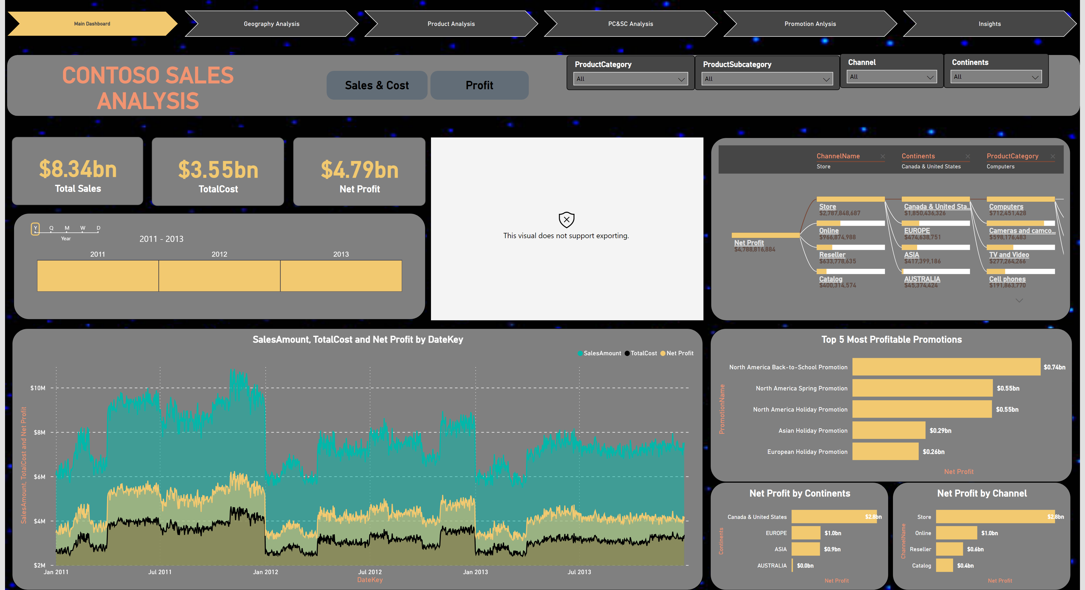
Main Dashboard
Notes:
Main Page
“Note !!”
The Figure Here Not Appear Because It Is Imported Chart.

Slide 3
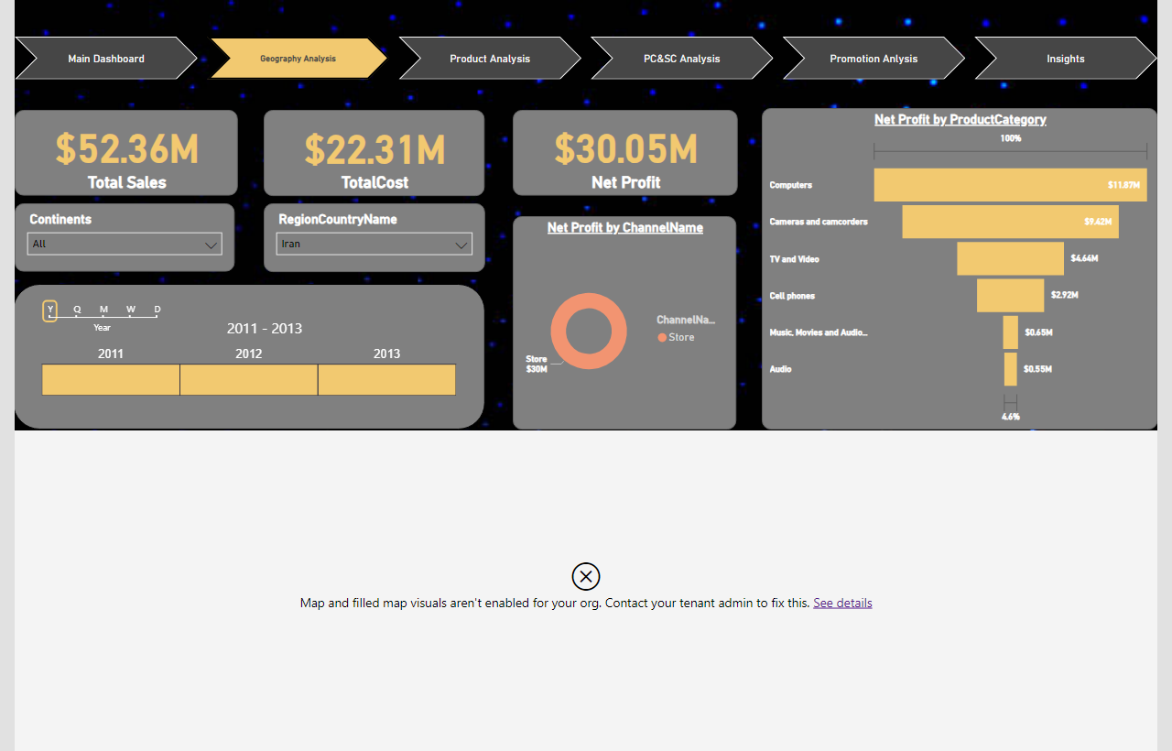
Geography Analysis
Notes:
Geography Analysis Page
“Note !!”
The Map Not Appear because Using Student Mail In Power BI Sign In

Slide 4
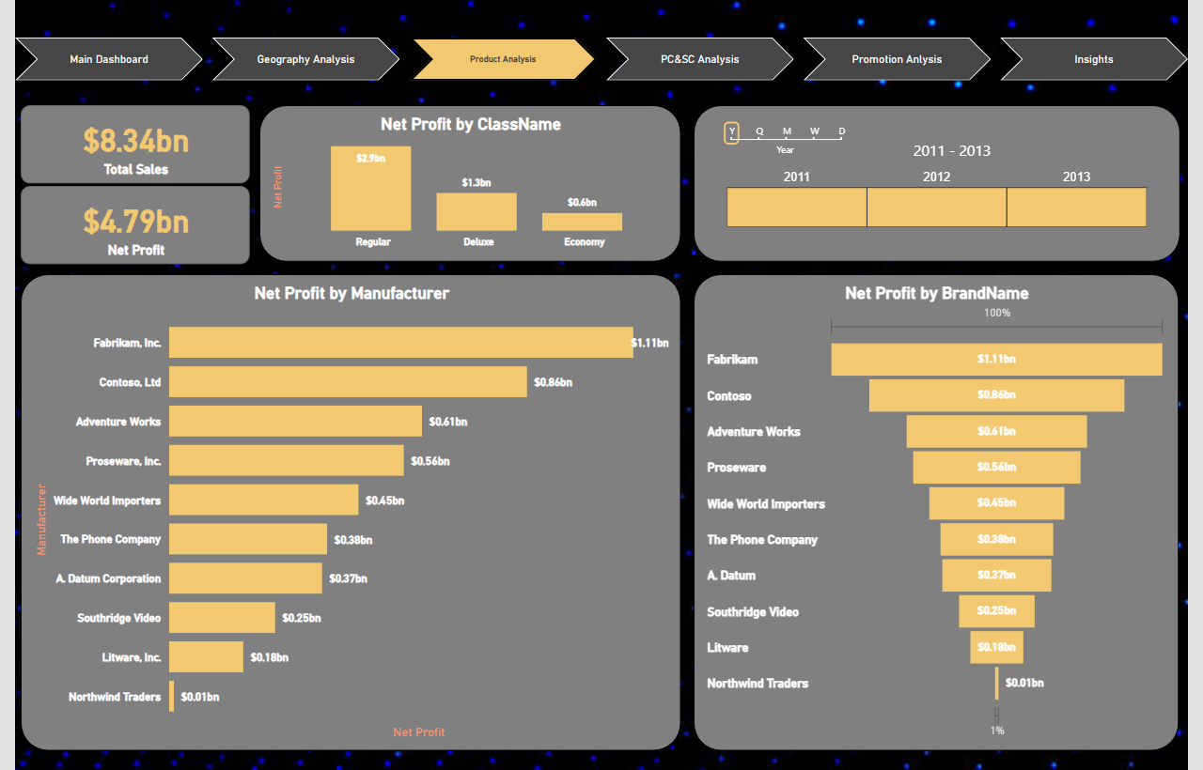
Product Analysis
Notes:
Product Analysis Page

Slide 5
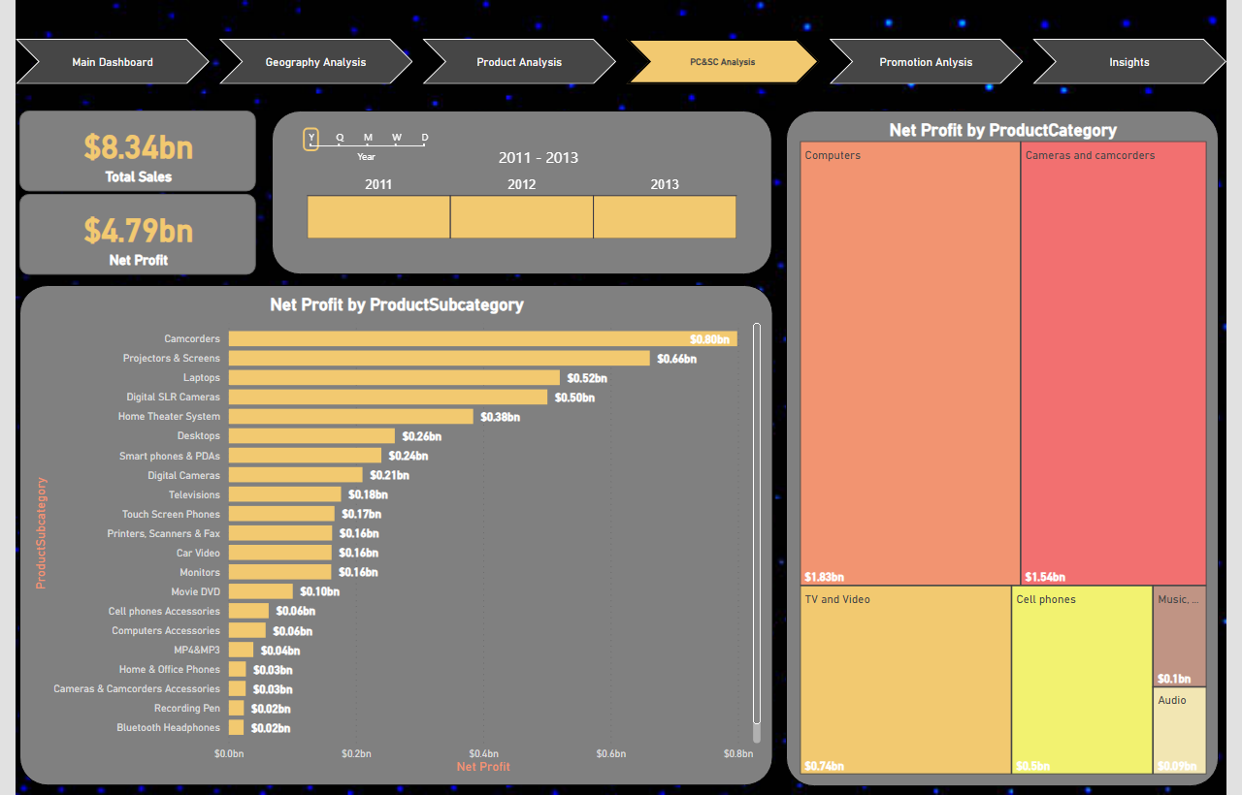
PC&SC Analysis
Notes:
Product Category Analysis & Product Subcategory Analysis Page

Slide 6
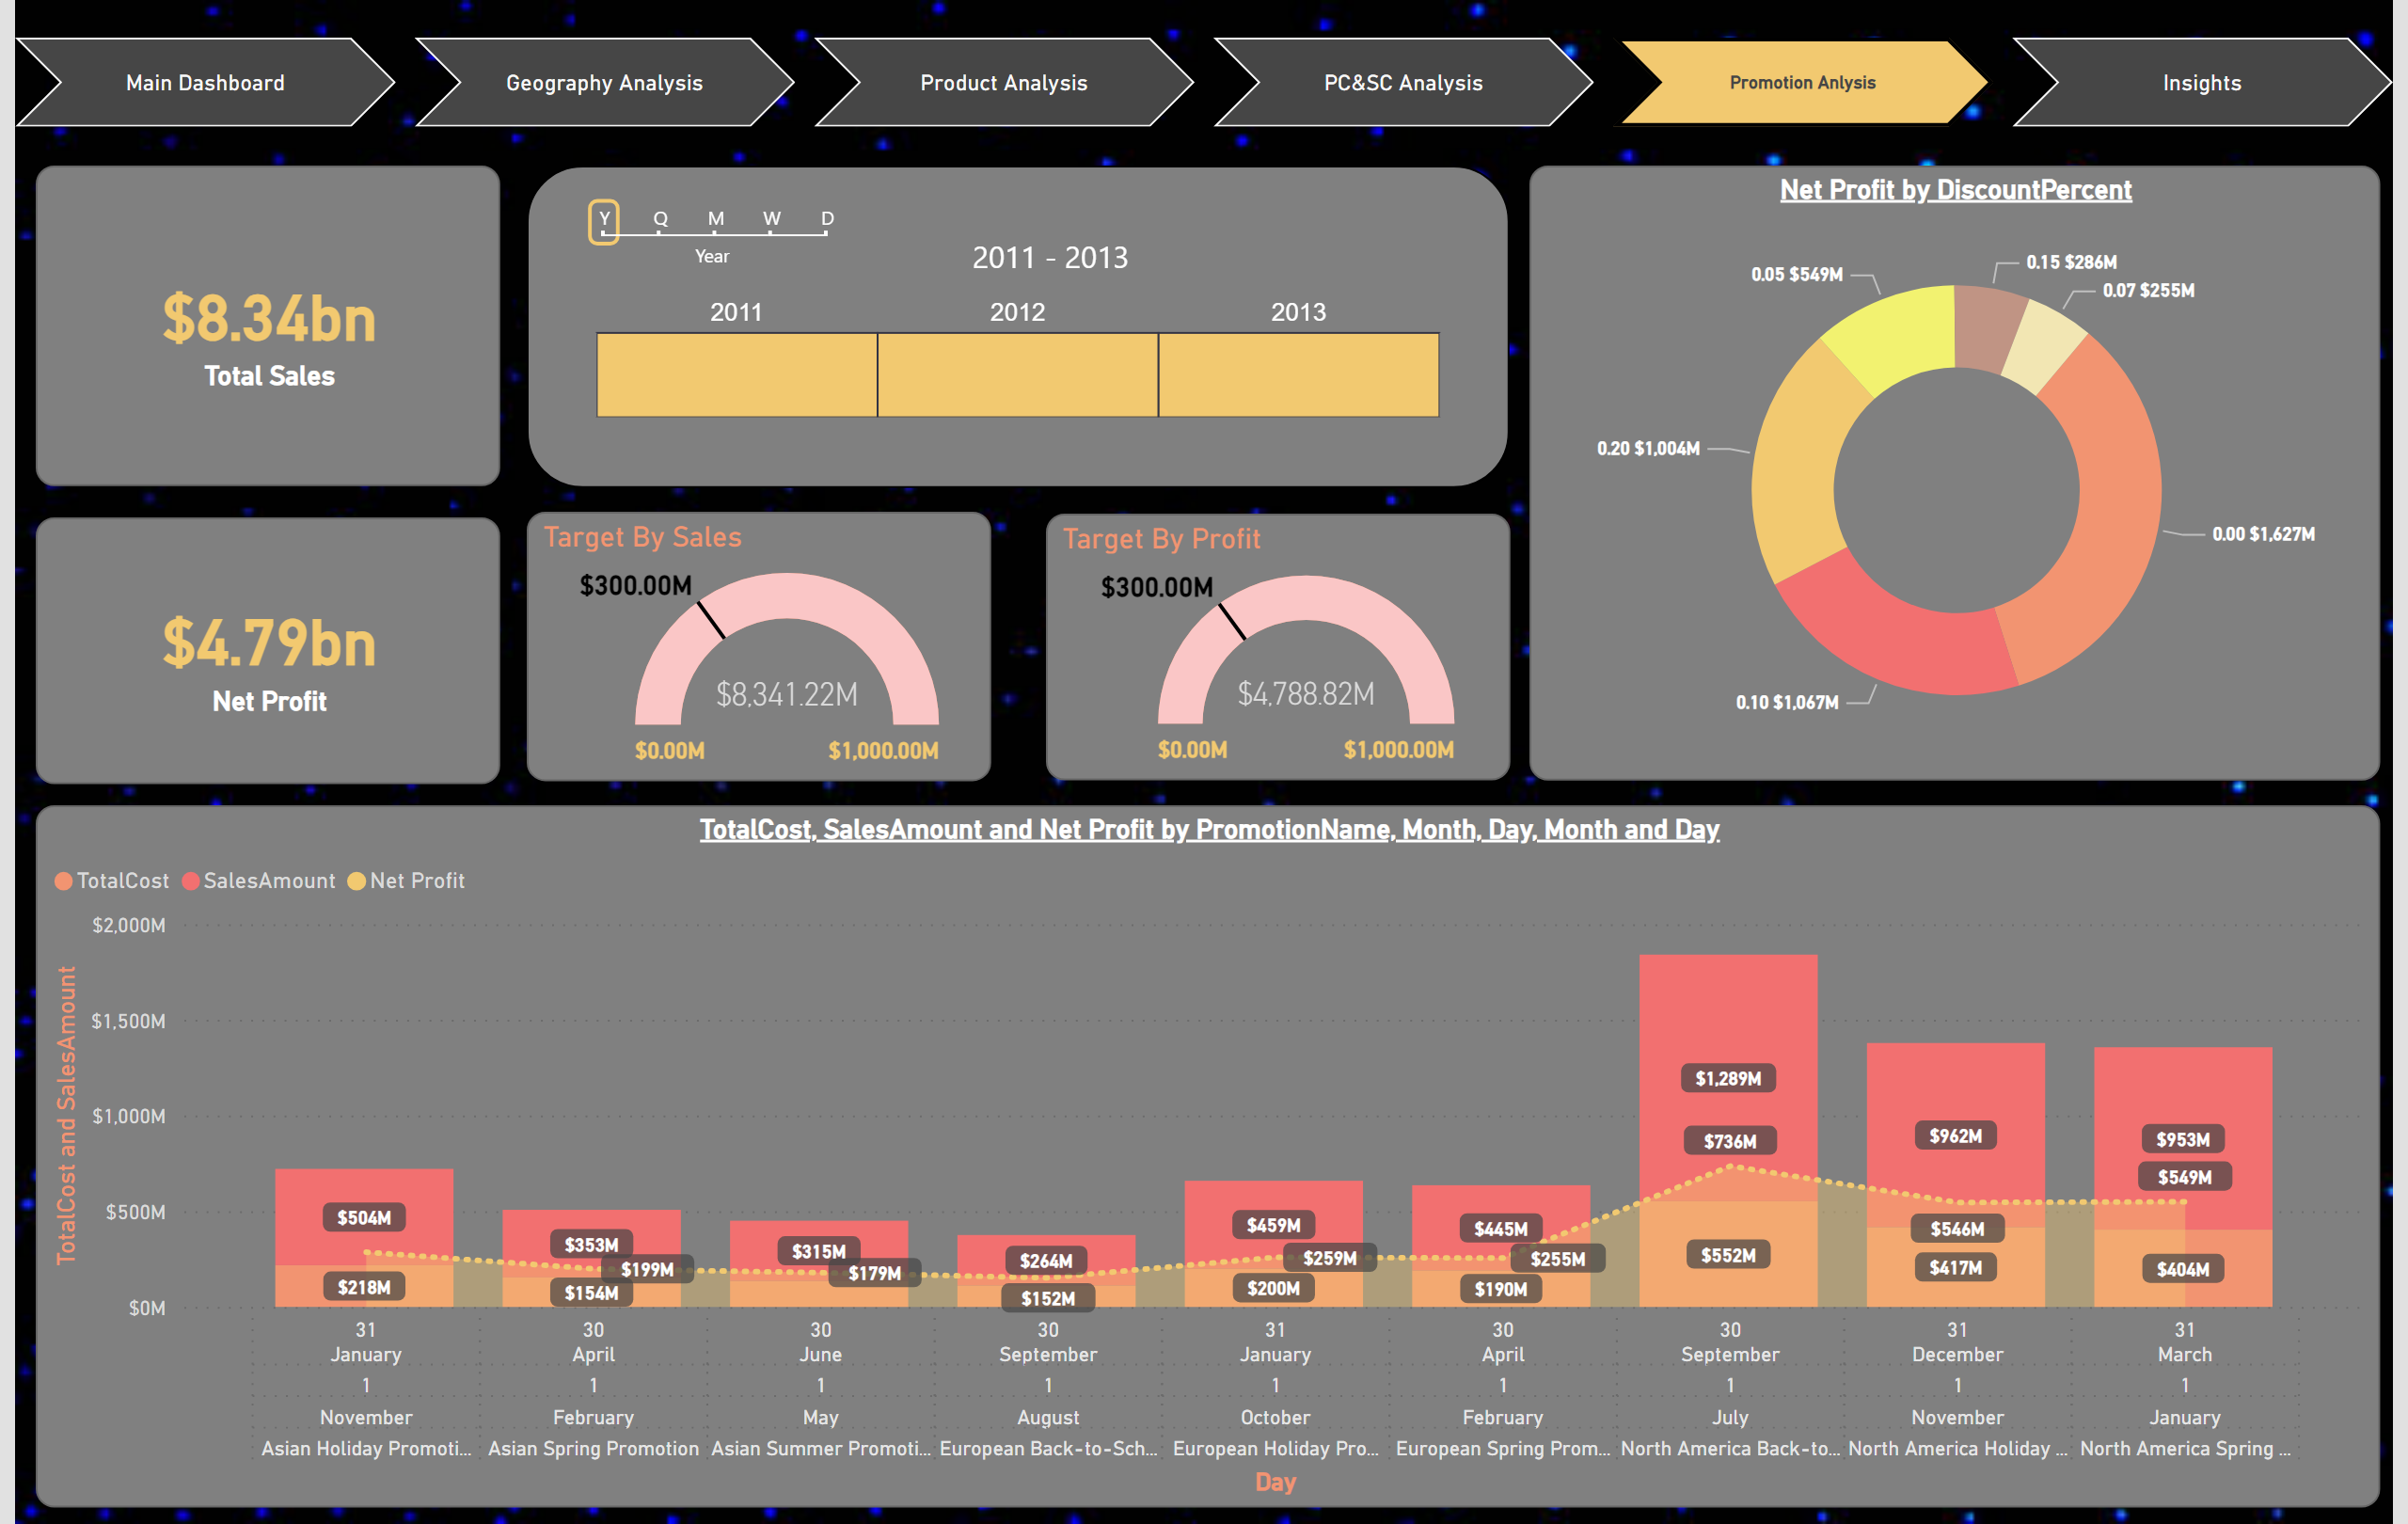
Promotion Anlysis
Notes:
Promotion Analysis Page

Slide 7
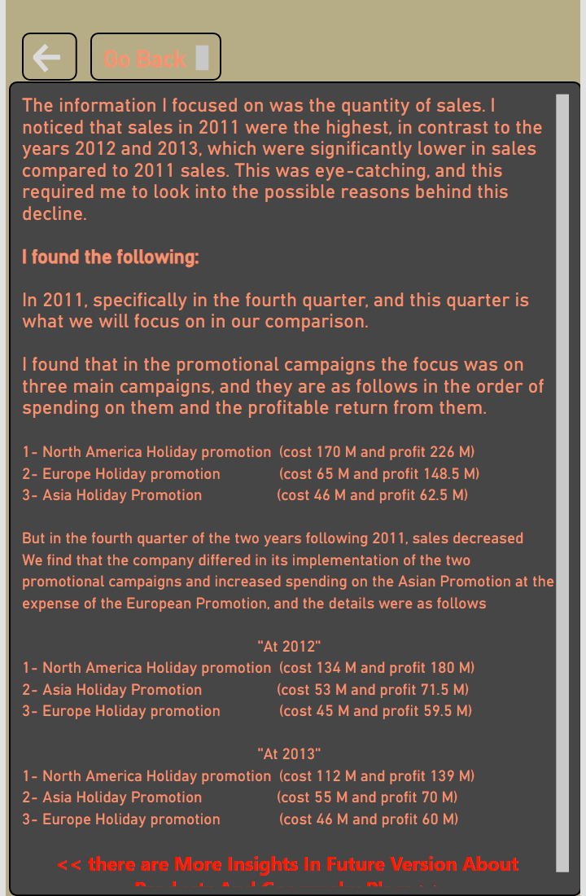
Insights
Notes:
textbox
That’s The Insights

Slide 8
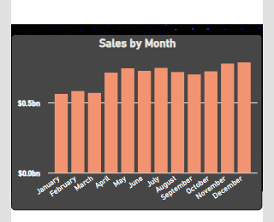
Tooltips
Notes:
Sales by Month
Just Tool Tips

Slide 9
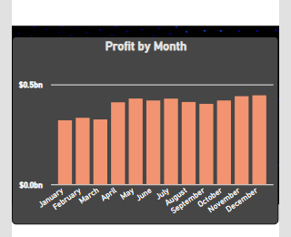
Tooltips1
Notes:
Profit by Month
Just Tool Tips

